Slide 1



Vidyavardhaka College of Engineering, Mysuru
Autonomous Institute, Affiliated to VTU
Accredited by NBA | NAAC with ‘A’ Grade
Engineering Exploration Lab [21AE27]
Academic Year 2021-2022
A Project Presentation on
“SMART BRIDGE USING AURDINO”
Presented by
SOUPARNIKA S [4VV21EC149]
SUHAS DD [4VV21EC158]
DHANUSHREE B [4VV21IS033]
ANKIT TIMMAPUR [4VV21IS015]
HARISH GOWDA H R [4VV21AI016]
CHANDANA M [4VV21CI015]
Under the Guidance of
Prof .Sharmila A
Asst. professor,
Dept of civil engg,
VVCE,Mysuru.

Slide 2
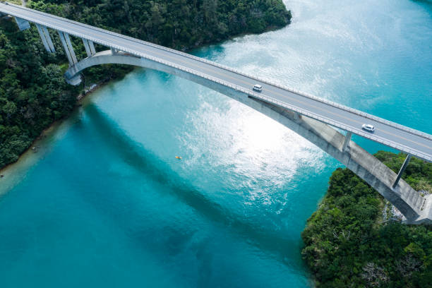

CONTENTS
1.Introduction.
2. Components required.
3. Cost Estimation.
4.Methodology.
5. Advantages and Disadvantages .
6.Application.
7.Conclusion.
8. Reference.

Slide 3
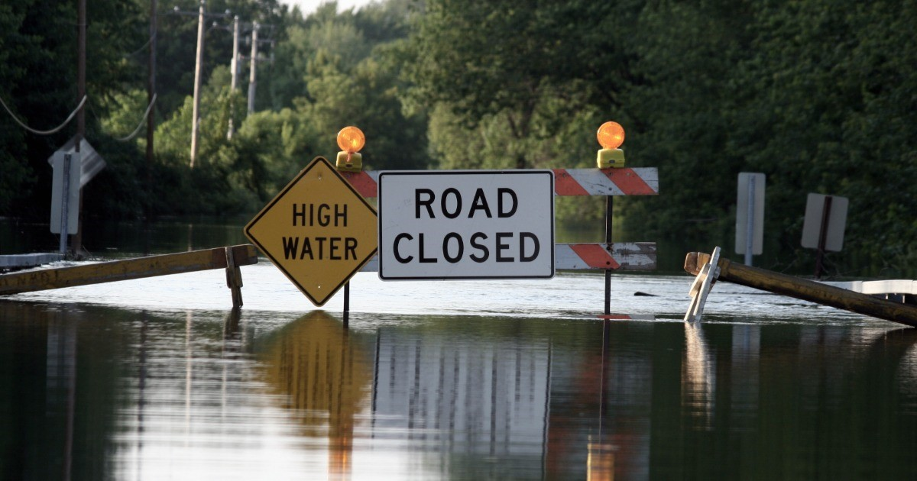
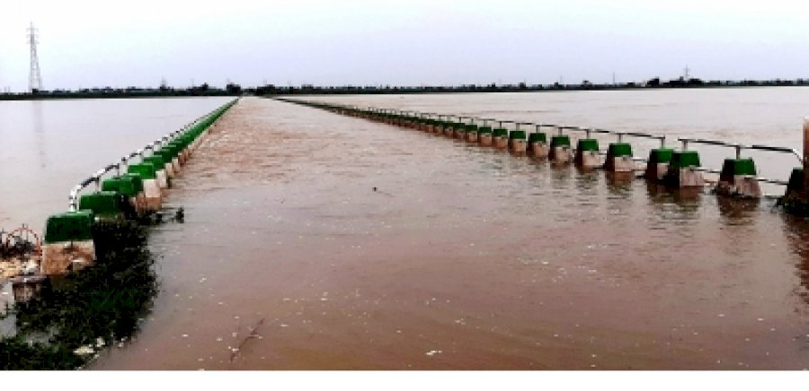
INTRODUCTION
During extreme rainy days , water level at the dams increases which leads to the overflow of water on the bridges constructed over the dam .This gives rise to various issues .
Some of the major issues are as follows :
1. The bridge gets flooded with extreme water.
2. People will not be able to cross the river.
3. Many other activities like Travelling, Transportation of goods via the bridge and etc would be stopped.
4. If the bridge is constructed from a Higher embankment region –lower embankment region or vice versa, the lower side region would be flooded which restricts movements and giving rise to traffic at the higher region.
Once such recently happened case was in Karnataka where 10 districts were flooded by Krishna river Spurt .
In order to overcome with this ,we came up with the idea of constructing a smart bridge which has a solution for all these issues .

Slide 4

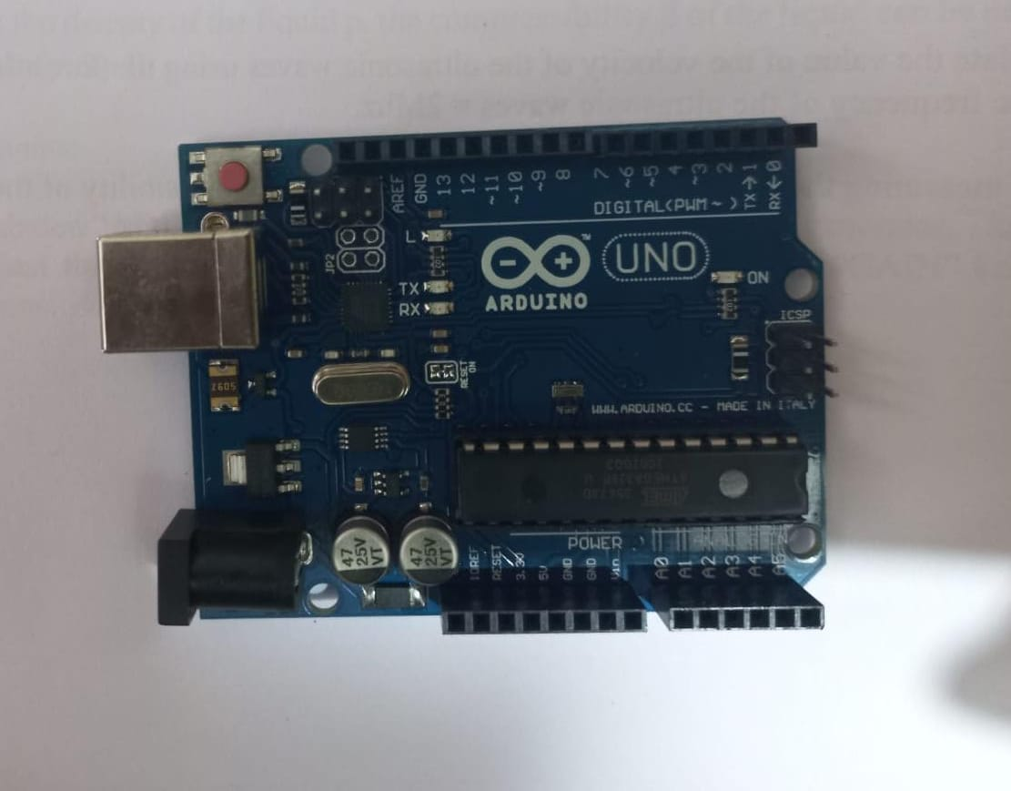
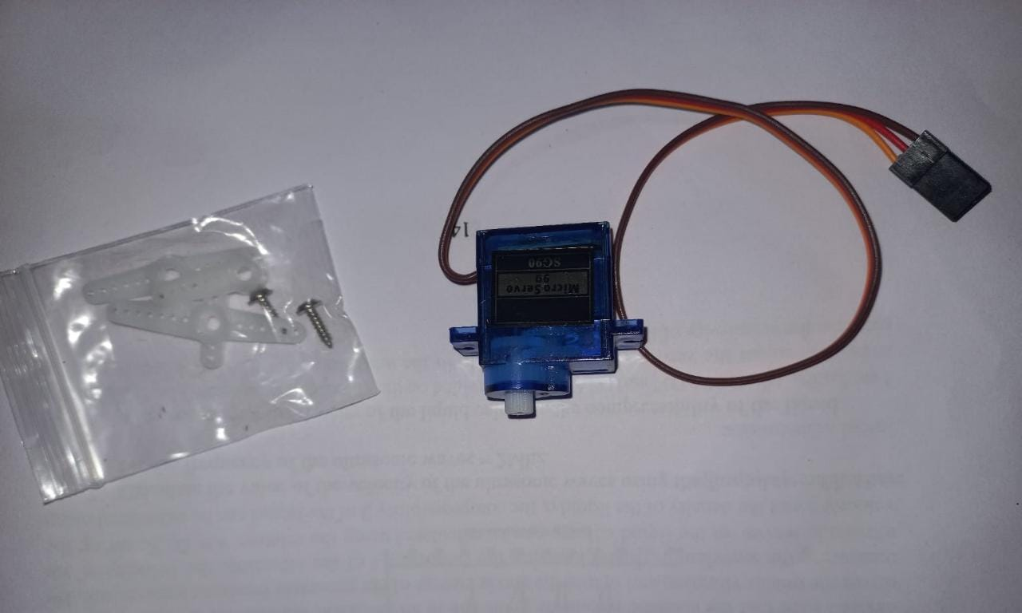
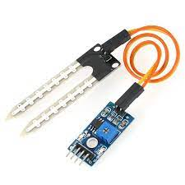
COMPONENTS REQUIRED
The following components were required to construct the smart bridge :
Aurdino UNO and Aurdino cable .
The Arduino UNO board is a micro-controller, mostly used in electronics project and to do programming in this board via the aurdino cable. The board has regular innovation and a bug fix in the design of the board to make the board suitable for the project’s use.
2.Servo motors.
Servo motor are used to perform a certain mechanical output as instructed by the micro-controller
3.Moisture sensors
Moisture sensors are used to detect/sense the water content ,water level and are designed to send the information to the controllers.
Aurdino UNO baoard
Servo Motors
Moisture sensor

Slide 5


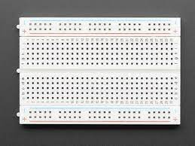
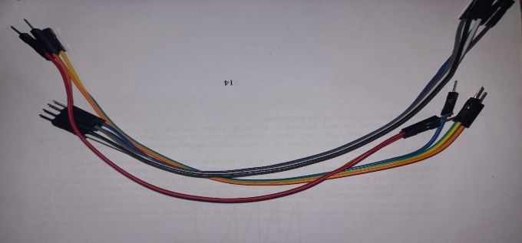
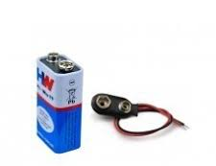
COMPONENTS REQUIRED
4. Small breadboard.
breadboard is used for building temporary circuits. It is useful to the person who wants to build a circuit to demonstrate its action.
5. Connecting wires.
Connecting wires are ued to connect two electronic components making it a complete circuit.
6. Batteries .
Batteries provide power for the circuit components to function.
Bread board
Connecting Wires
Batteries

Slide 6
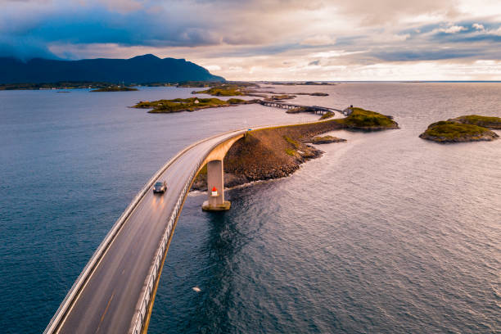
COST ESTIMATION
PARTICULARS | QUANTITY | COST
1. Aurdino UNO Board and Aurdino Cable . | 1 | 800
2. Servo Motors | 2 | 150X 2=300
3. Moisture Sensors | 2 | 130x2=260
4.Breadboard | 1 | 30
5. Batteries | 2 | 2X20=40
6. Thick cardboard and other extra materials | Lumpsum | 150
7. Connecting wires | Lumpsum | 50
TOTAL |  | 1630

Slide 7
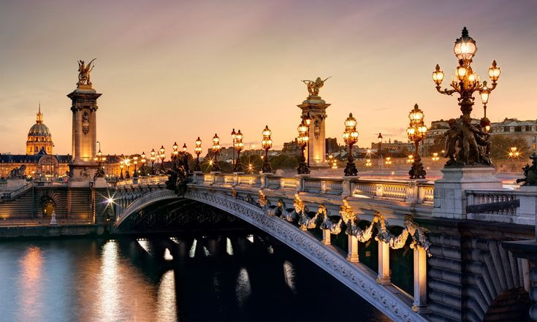
METHODOLOGY
Part -1 : Increementing the bridge height to avoid flooding of the bridge .
Once the moisture sensor which is attached underneath the bridge, detects water and the rise in water level in the dam ,passes the information to the microcontroller Aurdino UNO board . It contains a set of predefined instructions which is programmed into it.
It is further connected to servo motors which upon receiving the instructions from the microcontroller raises the level of the bridge by steps accordingly.
The height of the bridge is altered according to the instructions passed by the microcontroller which operates on the basis of information passed by the moisture sensors.
The height of the bridge automatically decreases as soon the moisture sensors detects the decrement in the water level under the bridge.

Slide 8
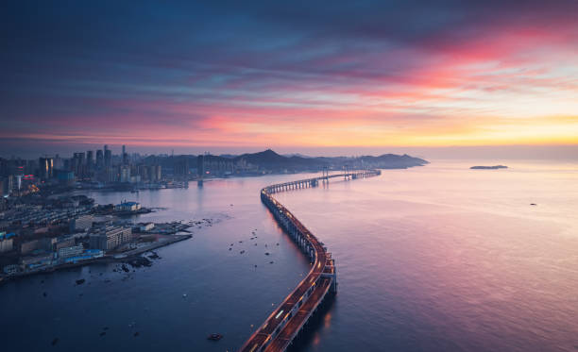
METHODOLOGY
Part-2 :Automatic Movement Restrictor
There will be another moisture sensor attached at the lower embankment area of the bridge which detects the rise in water level and passes the information to the microcontroller Aurdino uno which in turn, instructs the servo motor to release the barricade for the restriction of movement at the Higher embankment area .
This also makes the commutators at the higher embankment region aware of the flooding scenario taking place at the lower embankment region.

Slide 9
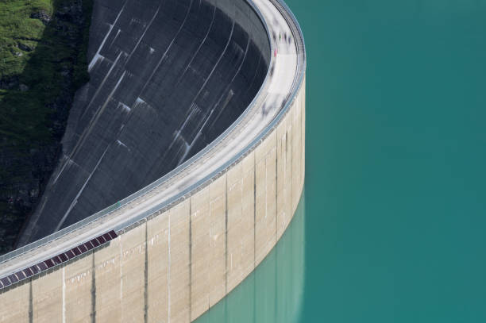
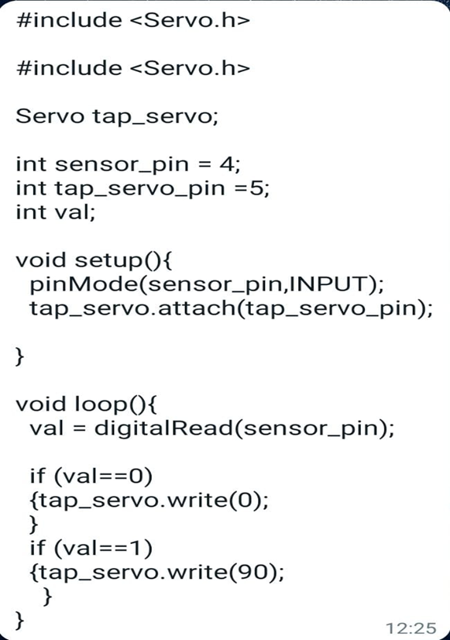
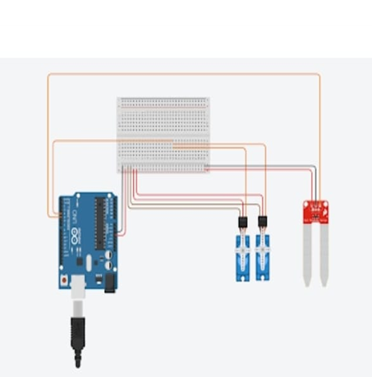
Circuit Diagram and AURDINO Code

Slide 10
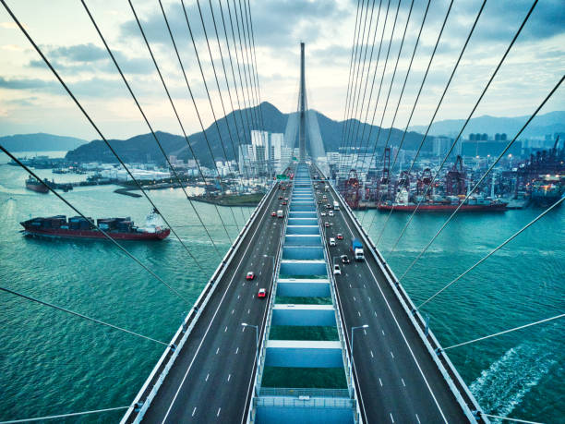


Work flow of the system
Part-1 : Increementing the bridge level
Detection by moisture sensor
Microcontroller Aurdino uno
Servo motor
Height is incremented
Part-2: Restricting movement automatically
Detection by moisture sensor
Microcontroller Aurdino uno
Servo motor
Barricade release

Slide 11


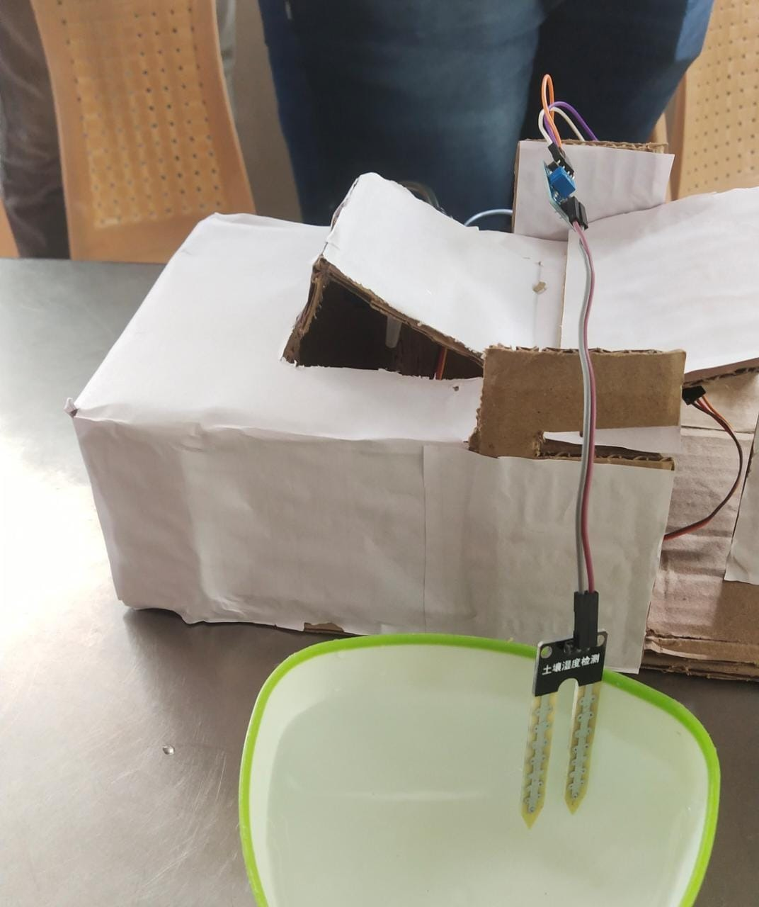
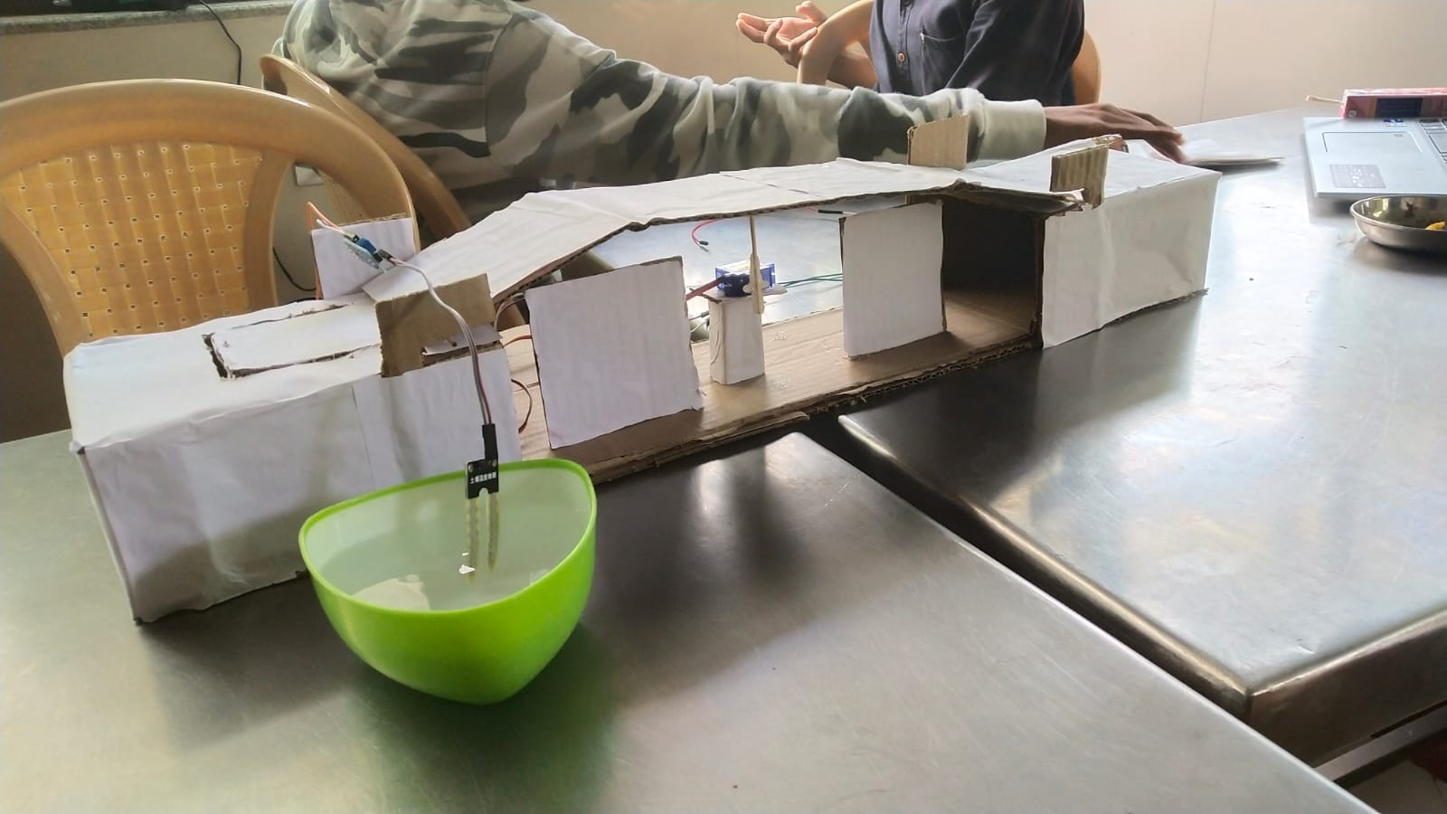
Images of the working model:
Part-1
Part-2

Slide 12
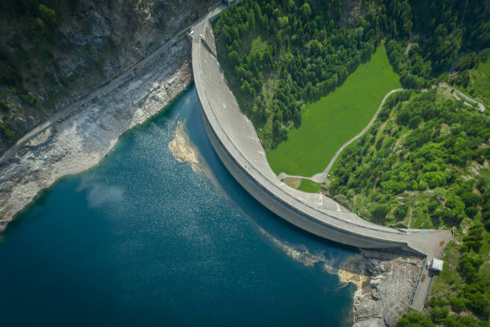
ADVANTAGES AND DISADVANTAGES
ADVANTAGES | DISADVANTAGES
1. Facilitates Transportation . | 1. Lot of power consumed for lifting the bridge .
2. Avoids overflow of water on the bridge. | 2. Electrical malfunctioning may occur .
3. Provides safety for people on the bridge from drowning also prevents flooding . | 3. High Maintainance and high cost.
4.Prevents the dam from Collapsing due to high pressure. | 4. Requires regular structural integrity test.

Slide 13
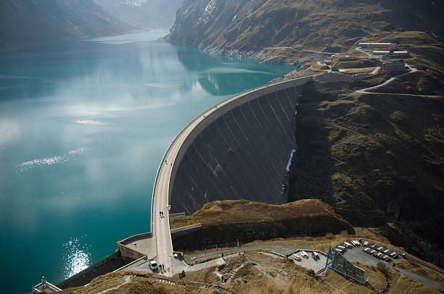
APPLICATIONS
1.Can be implemented in high flood prone areas like :ganga basin, indo-gangatic Brahmaputra plains ,etc.
2.Can also be implemented in more avalanche prone areas like Ladakh, kullu-spiti valleys etc where there is a frequent snow slide and which gets melted into water ,leading to increase in the water levels in the reservoirs.
3. Can be used at small dams with less water-holding capacities.

Slide 14
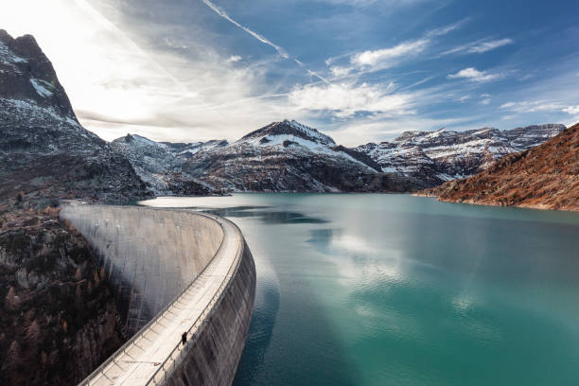
CONCLUSION
We being the responsible youth of our nation, would try our best to find solutions for the several existing problems in our society.
One such problem was the bridges getting flooded and collapsed due to excessive water which obstructs transportation.
We believe that we gave our best in constructing a small, smart bridge which would solve a pretty good number of issues and help in building a sustainable ,damageless environment for ourselves and also for the further generation.

Slide 15

REFERENCES
The following are our reference sources:
https://youtu.be/c-Zxa_dV7nk
https://youtu.be/2-zsQix2Ay0
https://youtu.be/66BicqTuEGM

Slide 16


